Slide 1

Verification
Computer System Principles, Fall 2018 (IPADS, SJTU)
Implementation meets specification
Mo Zou
Notes:
- 使大家对形式化验证的认知变得更系统一些

Slide 2
Software is error-prone
What is the best comment in source code you have ever encountered?
Top answers from stackoverflow
//When I wrote this, only God and I understood what I was doing
//Now, God only knows
// drunk, fix later
// Magic. Do not touch.

Slide 3
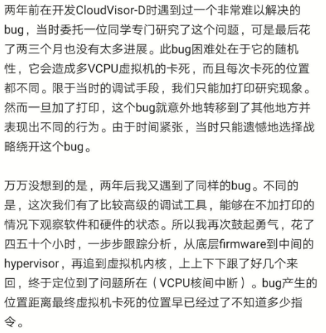
Bugs are difficult to detect and fix
“Program testing can be used to show the presence of bugs, but never to show their absence! ”---Edsger W. Dijkstra
A Ph.D.’s friend cycle
当时委托一位同学专门研究了这个问题，可是最后花了两三个月也没有太多进展。此bug的困难处在于它的随机性
所以我再次鼓起勇气，花了四五十个小时，一步步跟踪分析[…]终于定位到了问题所在

Slide 4
Do we have a way to ensure the correctness?
Formal verification
the only known way to guarantee that a software is free of programming errors
Mathematical methods
Fully verify that impl meets spec
Software testing
Formal verification
Notes:
- 形式化验证
- 与软件测试的区别
- 数学方法，完全验证

Slide 5
A beginner’s question/misunderstanding about verification
现有技术能够证明一个软件正确吗？
证明软件基于什么理论？
有实际软件是证明过的吗？
证明能保证软件完全正确。
证明需要很深的数学基础，我应该理解不了。
证明跟我没有关系，我以后也不会去做证明。

Slide 6
Outline
What is verification
A brief history of state-based verification
Verification techniques
Proof automation
Verification at academia and industry

Slide 7
What is verification

Slide 8
What to prove about a program
int x;
inc()
x = x + 1;
Safety property (functional correctness & invariant)---程序功能是否正确
Liveness property---程序是否终止
Security property---程序是否安全
Resource usage property---资源使用情况
Real-time property---时延情况
Atomicity, crash-safety, etc.
Operating system kernel

Slide 9
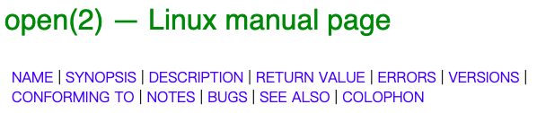
Specification describes what is desired
Specification is not unfamiliar to us
Comments in the code
Natural language document
Informal specification cannot be used in proofs
int x;
// inc() increments the value of x by 1
inc()
x = x + 1;

Slide 10
Formal specification
A category of specification that have rigorous meaning
Specification language
Math
Any language that is mathematically defined
E.g., type system
int x;
// inc() increments the value of x by 1
inc()
x = x + 1;
Formal specification
Precondition: x = N
Postcondition: x = N + 1

Slide 11
Implementation
Programs implemented in a programming language
E.g., C program
However, C has undefined behavior
Programming language should also be mathematically defined---i.e., defining the semantics
Develop a mathematical model of C subset
Exclude undefined behavior
i = i++ + 1;
int f() { }

Slide 12
What does impl. meet spec. mean?
Implementation
Impl. meet spec.
Specification
假如前置条件满足，执行完程序，后置条件被满足
前置后置条件
Pre: x = N
Post: x = N +1
假如x=N，执行完inc()，x=N+1
Some C program
inc()

Slide 13
What does impl. meet spec. mean?
Correctness condition
Implementation
Impl. meet spec.
Specification
假如前置条件满足，执行完程序，后置条件被满足
前置后置条件
程序执行前满足不变式，程序每执行一步都满足不变式
不变式
Some C program
假如前置条件满足，程序能够执行完并且后置条件满足
前置后置条件+终止性
程序每执行一步，假如发生崩溃，状态仍然一致
崩溃一致性

Slide 14
Correctness condition defines what impl. meets spec. means
Implementation
Correctness condition
Specification
Math definition of I meets S
I: A math model
S: A math model
Different correctness condition for different specification
Two most used specification & correctness condition for functional correctness---details later

Slide 15
Proof establishes correctness condition
Implementation
Correctness condition
Specification
Math definition of I meets S
I: A math model
S: A math model
Proof
Proof needs to be machine-checked
Automatic proof technique

Slide 16
Summary: four parts to verification
Specification: a precise description of the desired behavior of a system
Implementation: an implementation of a system
Correctness condition: what “impl meets spec” means
Proof: mathematical proof showing implementation meets specification
Notes:
四个组成部分
- 规约：精确描述期待行为
- 正确性条件：证明目标，实现与规约一致意味着什么，到底证了什么？
- 证明

Slide 17
A brief history of state-based verification

Slide 18
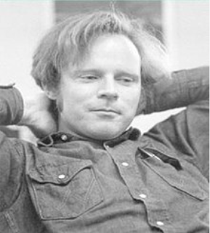
Specifying sequential correctness
Correctness for sequential programs
1967
First proposed by Robert W. Floyd in 1967
Receive Turing Award in 1978

Slide 19
Specifying sequential correctness
Correctness for sequential programs
1967
Annotate each control point with an assertion
int x;
inc() {
int tmp;
tmp = x;
tmp = tmp + 1;
x = tmp;
}
Pre
Proof decomposed into verification of each statement
E.g., Assn_{i} Command_{i} Assn_{i+1}
Assn1
Assn2
Assn3
Post

Slide 20
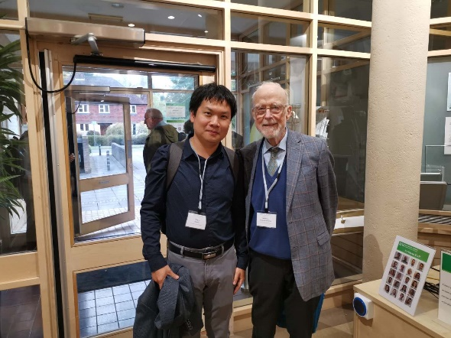
A logical framework for proving sequential program
Correctness for sequential programs
1967
1969
A logical framework for proving sequential correctness
Tony Hoare recast Floyd’s method into a logical framework, known as Hoare Logic (or Floyd-Hoare Logic)
Receive Turing Award in 1980
Formula in Hoare Logic: P {S} Q
Inference rules for proving

Slide 21
Floyd and Hoare changed the way to think of programs
Not as an event generator, but as a state transformer
State are close to everyday mathematics
Described in terms of numbers, sequences, sets, functions and so on
E.g., C struct --> sequence
E.g., C map --> function
Reduce program reasoning into mathematical reasoning

Slide 22
History of state-based verification
Correctness for sequential programs
Extend Hoare’s method to concurrency
1967
1969
1976
A logical framework for proving sequential correctness
A long period of time without much progress
Because state model only has stores
Store: mapping of variable to values
Can’t reason about pointer program, i.e., program with heap

Slide 23
History of state-based verification
Correctness for sequential programs
Extend Hoare’s method to concurrency
Concurrent separation logic
1967
1969
1976
2002
2004
…
A logical framework for proving sequential correctness
A logic for pointer program
Separation logic (2002): logic for pointer program
Concurrent separation logic (2004)
After that, theories get more and more complete for practical systems

Slide 24
Verification techniques

Slide 25
How would you prove that this program is functional correct
int x;
inc()
x = x + 1;
1. Give a math model of the implementation
2. Give a mathematically defined specification
3. Define correctness condition
4. Prove correctness condition
Notes:
如何证明一个程序，程序是由语言写的，首先需要对语言进行建模
- 语法
- 内存模型，或程序状态
- 语义
- spec：如何描述程序状态
- 怎么定义正确

Slide 26
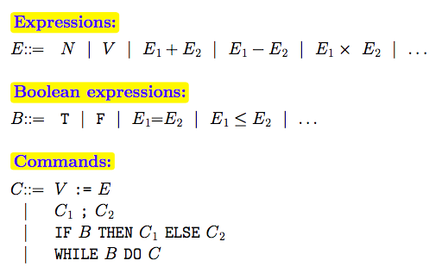
Modelling programming language
Syntactics (语法)
State model (状态模型)
Semantics (语义)
Syntactics for a toy language

Slide 27
Modelling programming language
Syntactics (语法)
State model (状态模型): state that the language operate
Semantics (语义)
 | A toy language | C language
State model | 变量名到值的映射（E.g., X -> 1） | 全局符号表，局部符号表，内存（地址到值的映射）

Slide 28
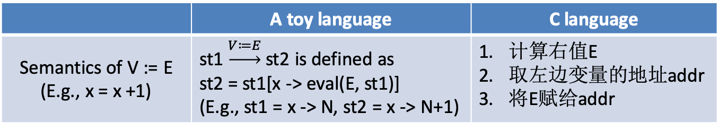
Modelling programming language
Syntactics (语法)
State model (状态模型)
Semantics (语义): how program modifies the state
 | A toy language | C language
Semantics of V := E (E.g., x = x +1) | st1 $\underset{→}{V≔E}$ st2 is defined as st2 = st1[x -> eval(E, st1)] (E.g., st1 = x -> N, st2 = x -> N+1) | 计算右值E 取左边变量的地址addr 将E赋给addr

Slide 29
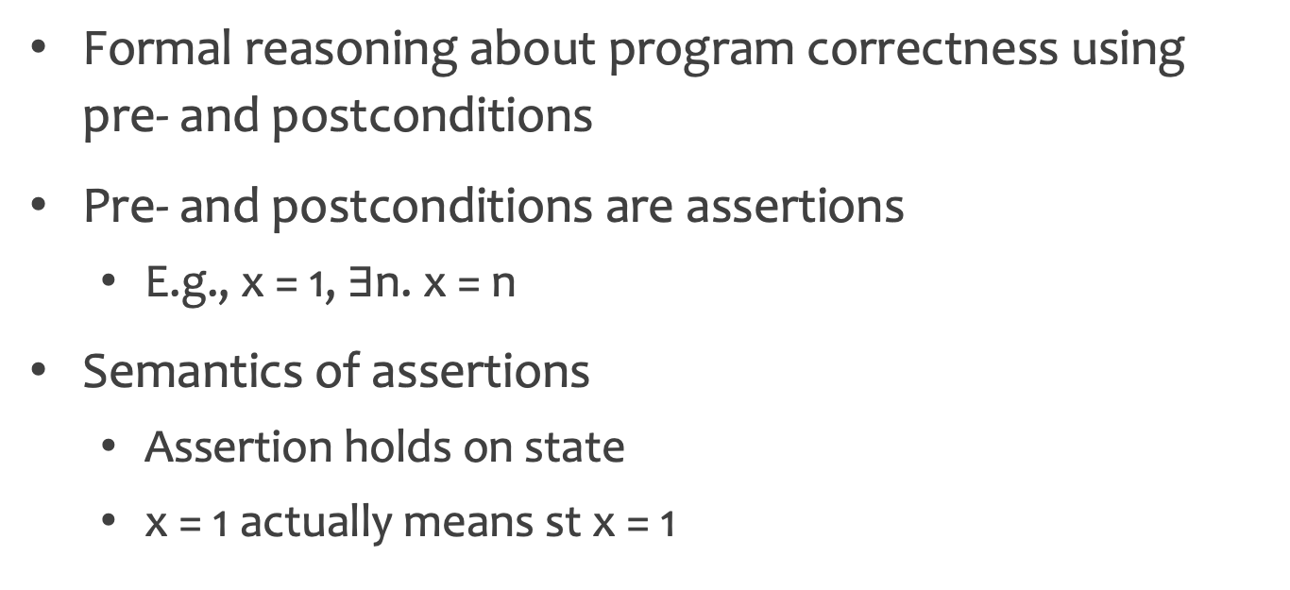
Using Hoare Triple as specification
Formal reasoning about program correctness using pre- and postconditions
Pre- and postconditions are assertions
E.g., x = 1, $∃$n. x = n
Semantics of assertions
Assertion holds on state
x = 1 actually means st x = 1

Slide 30
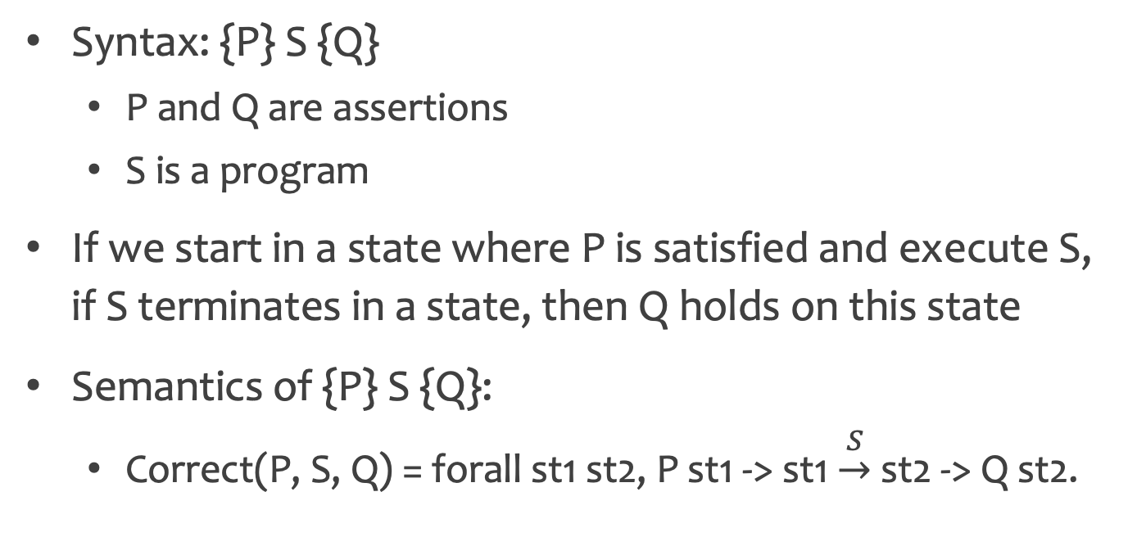
Using Hoare Triple as correctness condition
Syntax: {P} S {Q}
P and Q are assertions
S is a program
If we start in a state where P is satisfied and execute S, if S terminates in a state, then Q holds on this state
Semantics of {P} S {Q}:
Correct(P, S, Q) = forall st1 st2, P st1 -> st1 $\underset{→}{S}$ st2 -> Q st2.

Slide 31
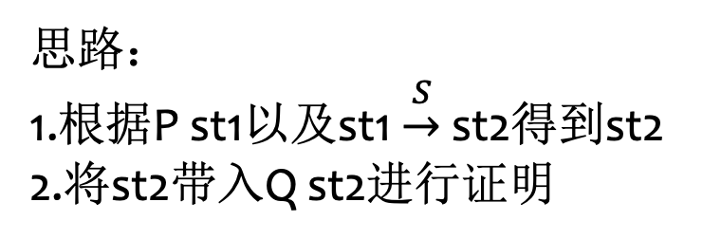
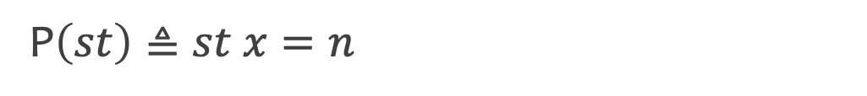
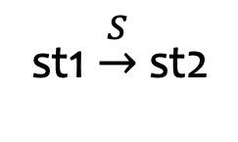
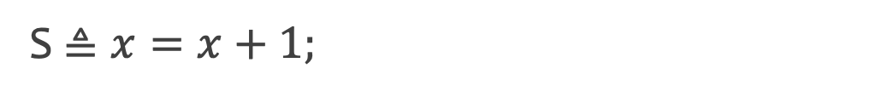
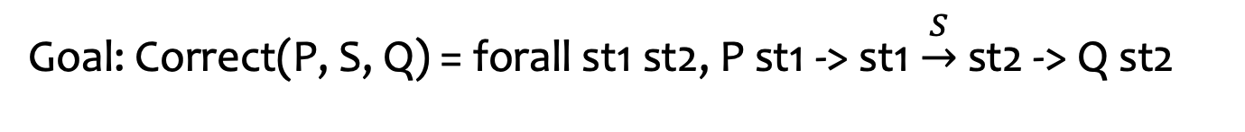
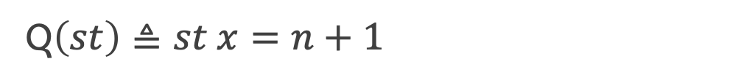
How would you prove that this program is functional correct
P$\left(st\right)≜st x=n$
int x;
inc()
x = x + 1;
Q$\left(st\right)≜st x=n+1$
S$≜x=x+1;$
Goal: Correct(P, S, Q) = forall st1 st2, P st1 -> st1 $\underset{→}{S}$ st2 -> Q st2
st1 $\underset{→}{S}$ st2
思路：
1.根据P st1以及st1 $\underset{→}{S}$ st2得到st2
2.将st2带入Q st2进行证明
Given
P st1
Prove
Q st2

Slide 32
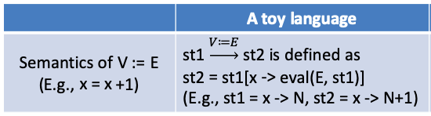
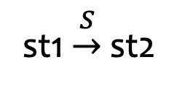
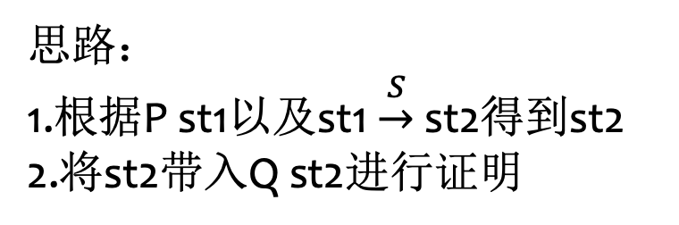
How would you prove that this program is functional correct
st1 $\underset{→}{S}$ st2
思路：
1.根据P st1以及st1 $\underset{→}{S}$ st2得到st2
2.将st2带入Q st2进行证明
Given
P st1
Prove
Q st2
Given
st1 x = n
st2=st1[x->n+1]
Prove
st2 x=n+1
Prove
st1[x->n+1] x=n+1

Slide 33
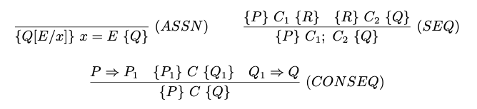
Hoare Logic: a logical framework for proving sequential program
A set of inference rules for proving
Syntactical proving instead of semantics proving

Slide 34
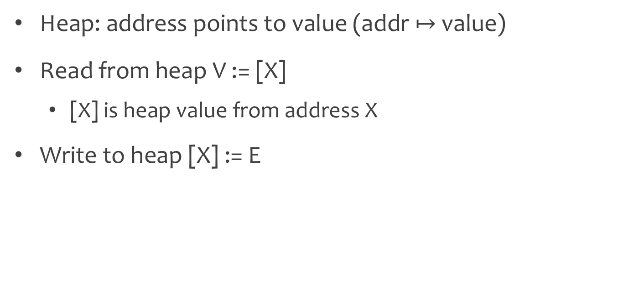
Enrich program state with heap
Heap: address points to value (addr $↦$ value)
Read from heap V := [X]
[X] is heap value from address X
Write to heap [X] := E
int *x, y;
inc2()
[x] = [x] + 1;
[y] = [y] + 1;

Slide 35


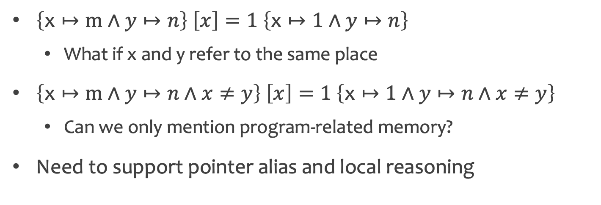
Challenges with heap
$\left\{\text{x}↦\text{m}∧y↦n\right\} \left[x\right]=1 \left\{\text{x}↦\text{1}∧y↦n\right\}$
What if x and y refer to the same place
$\left\{\text{x}↦\text{m}∧y↦n∧x≠y\right\} \left[x\right]=1 \left\{\text{x}↦\text{1}∧y↦n∧x≠y\right\}$
Can we only mention program-related memory?
Need to support pointer alias and local reasoning

Slide 36
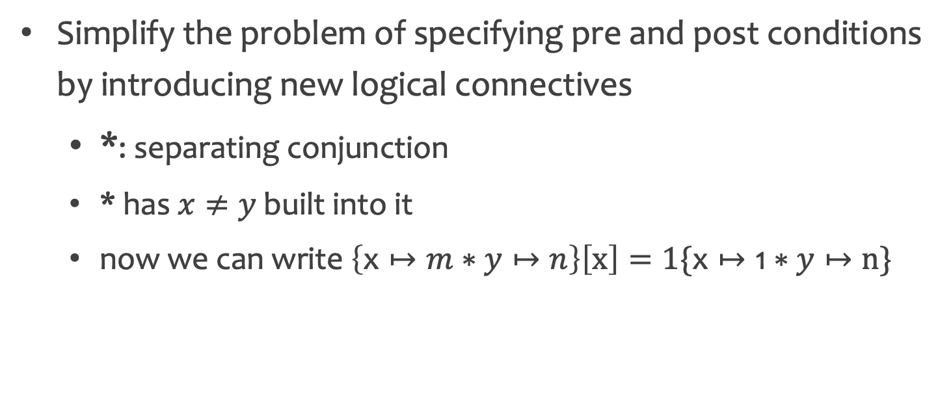
Separation Logic
Simplify the problem of specifying pre and post conditions by introducing new logical connectives
*: separating conjunction
* has $x≠y$ built into it
now we can write $\left\{\text{x}↦m∗y↦n\right\}\left[x\right]=1\{\text{x}↦\text{1}∗y↦n\}$

Slide 37
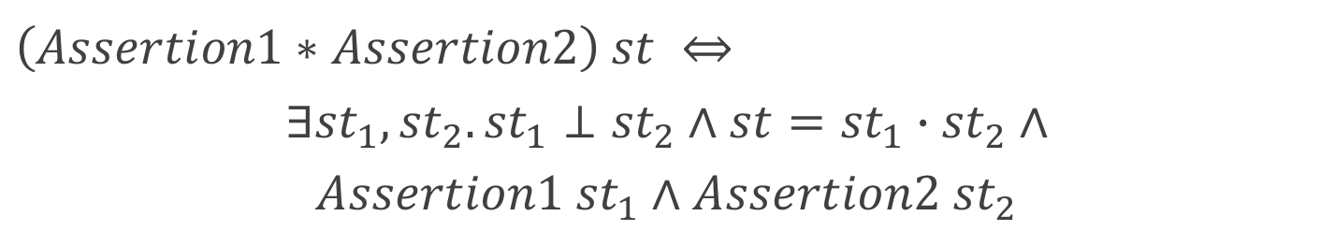
Meaning of separation conjunction
Separation conjunction
Assertion1
Assertion2
State1
Prop1
*
State2
Prop2
Assertion3
=
State1
Prop1
disjoint
with
State1
State2
State2
Prop2
$$\left(Assertion1∗Assertion2\right) st ⇔$$
$$∃{st}_{1},{st}_{2}.{st}_{1}⊥{st}_{2}∧st={st}_{1}∙{st}_{2}∧$$
$$Assertion1 {st}_{1}∧Assertion2 {st}_{2}$$
Solve address alias

Slide 38
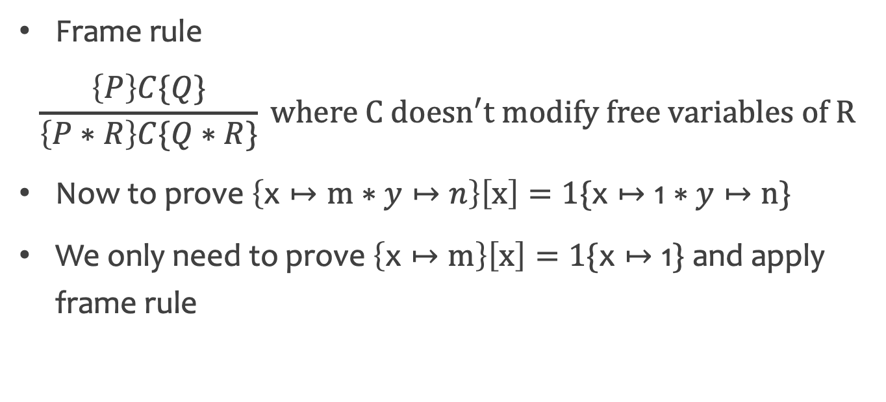
Separation conjunction allows local reasoning
Frame rule
$$\frac{\left\{P\right\}C\{Q\}}{\left\{P∗R\right\}C\{Q∗R\}} where C doesn^{′}t modify free variables of R$$
Now to prove $\left\{\text{x}↦\text{m}∗y↦n\right\}\left[x\right]=1\{\text{x}↦\text{1}∗y↦n\}$
We only need to prove $\left\{\text{x}↦\text{m}\right\}\left[x\right]=1\{\text{x}↦\text{1}\}$ and apply frame rule

Slide 39
Summary so far
Hoare logic
Spec: {Pre} {Post}
Impl: S
Correctness condition: Correct(Pre, S, Post)
Proof: show Correct(Pre, S, Post) establishes
Separation logic: extend Hoare logic with separation conjunction to reason about heaps

Slide 40
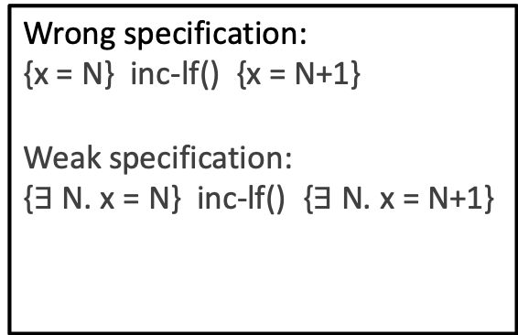
Limitation of Hoare Triple
Not expressive enough
Concurrent interference makes assertion un-stable
int x;
inc-lf() {
int done=0, tmp;
while(!done){
tmp = x;
done = cas(&x, tmp, tmp+1);
}
}
Wrong specification:
{x = N} inc-lf() {x = N+1}
Weak specification:
{$∃$ N. x = N} inc-lf() {$∃$ N. x = N+1}

Slide 41
Limitation of Hoare Triple
Not expressive enough
Concurrent interference makes assertion un-stable
Some server program never ends
Precondition: P
while(true){
…
}
Postcondition: False

Slide 42
Limitation of Hoare Triple
Not expressive enough
Concurrent interference makes assertion un-stable
Some server program never ends
Hoare Triple describes programs intentionally
不识庐山真面目，只缘身在此山中
Can we describe programs extensionally?

Slide 43
Observable behavior
Character program from the observable behavior
Internal observer: program state
External observer: program output or abort
E.g., externally observable behavior of main is {(0,1)}
int x=0;
main()
print(x);
inc-lf();
print(x);

Slide 44
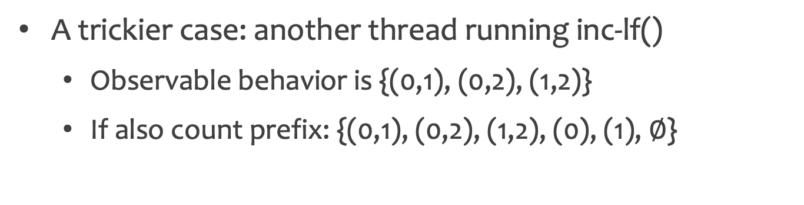
Observable behavior (Cont)
A trickier case: another thread running inc-lf()
Observable behavior is {(0,1), (0,2), (1,2)}
If also count prefix: {(0,1), (0,2), (1,2), (0), (1), $∅$}
Given x = 0
thread1:
print(x);
inc-lf();
print(x);
thread2:
inc-lf();
What if another program produce the same behavior?

Slide 45
Another program with same observable behavior
Given x = 0
replace inc-lf() with
thread1:
print(x);
inc-lf();
print(x);
thread2:
inc-lf();
inc-lock()
lock;
x=x+1;
unlock;
The new program can serve as the specification for the old program, and vice versa.

Slide 46

Refinement relation
If program A has no more behavior than program B, than A refines B (A是B的一个精化)
behavior of A
behavior of B
$$⊆$$
int x=0;
main()
print(x);
inc-lf();
print(x);
int x=0;
main()
print(x);
inc-lock();
print(x);
and
refines each other

Slide 47
Refinement relation (Cont)
If program A has no more behavior than program B, than A refines B (A是B的一个精化)
Why no more---spec is more loose than impl
Spec: you can return x or y
Impl: I choose to return x

Slide 48
Refinement relation examples (1)
int x=0;
main()
print(x);
x = x+1;
print(x);
int x=0;
main()
print(x);
x = x+1;
print(x);
print(x);
full trace
{(0,1)}
{(0,1,1)}
prefix trace
{(0,1), (0), ∅}
{(0,1), (0), ∅, (0,1,1)}
Depends on definition of behaviors

Slide 49
Refinement relation examples (2)
int x=0;
main()
print(x);
x = x+1;
print(x);
int y=0;
main()
print(y);
y = y+1;
print(y);
Implementation doesn’t matter. Program A and B can use even different language

Slide 50
Refinement relation examples (3)
int x=0;
main()
print(x);
x = x+1;
print(x);
int y=1;
main()
print(y);
y = y+1;
print(y);
int x=0;
main()
print(x);
x = x+1;
print(x);
int y=2;
main()
print(y-2);
y = y-1;
print(y);
case (1)
case (2)
For two un-related program, the refinement is not useful
We usually request the initial state of two program map
E.g., in case (1), we require x = y

Slide 51

Refinement definition
Impl. refines spec. is defined as
Impl.
Initial state s
Observable behavior O1
related
$$⊆$$
Spec.
Initial state S
Observable behavior O2

Slide 52
Context
Impl. and spec. are full program (E.g., impl1 and impl2)
We only care about the inc implementation
Impl1
Impl2
main()
print(x);
inc-lf();
print(x);
thread1:
print(x);
inc-lf();
print(x);
thread2:
inc-lf();
Need a correctness condition that generalizes context

Slide 53
Contextual refinement
Context
inc-lf();
refines
inc-lock();
For any context, invoking impl. refines invoking spec, then impl. is the contextual refinement of spec.

Slide 54
What is unsaid?
How to prove contextual refinement?
Consider all possible context?
Ans: simulation
How to prove concurrent context?
Consider all possible interleavings?
Ans: CSL and RG
How to prove other properties?
Many open problems!

Slide 55
Summary so far
Introduce some widely used verification techniques
Hoare Logic and Separation Logic
Refinement
Foundation for verifying practical systems
How do these theories apply to practical systems?
Are there new challenges?

Slide 56
Proof automation

Slide 57
Theorem proving is costly
seL4: the first verified microkernel [SOSP’09]
A milestone in verification history
8700 lines of C and 600 lines of assembler
Total proof effort is 25 py (person year)
Redoing a similar proof requires 8 py
Do we have better ways to do proofs?

Slide 58
Classification of proof methods
 | Push-button verification | Auto-active verification | Interactive verification
中文 | 一键证明 | 半自动证明 | 交互式证明
自动化程度 | 高 | 中 | 低
证明能力 | 低 | 中 | 高
证明 | SMT Solver | SMT Solver | 手动
包含范围 | 符号执行、模型检验 | 最弱前置条件、Dafny | Coq、Isabelle/HOL
问题 | 无法处理无界循环 | 无法处理并发 | 成本高

Slide 59
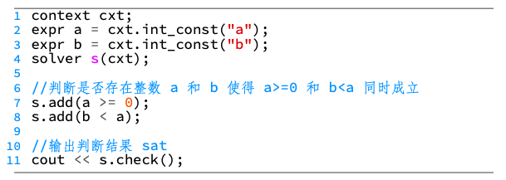
SMT solver
Automatically decide whether some first-order logic formula is solvable
Output unsat or give an example
Mostly used SMT solver: Z3

Slide 60
Use SMT solver in verification
Encode correctness condition as C
Check if ~C holds
“unsat” means C always holds
Otherwise give a counter-example when C doesn’t hold

Slide 61
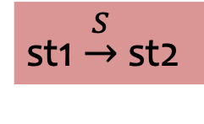
Push-button verification---symbolic execution
Symbolic execution: treat input as symbolic
int x;
inc()
x = x + 1;
st1 $\underset{→}{S}$ st2
Given
P st1
Prove
Q st2
Interpret the program and compute st2
Leave Z3 to prove the goal

Slide 62
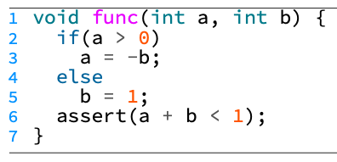
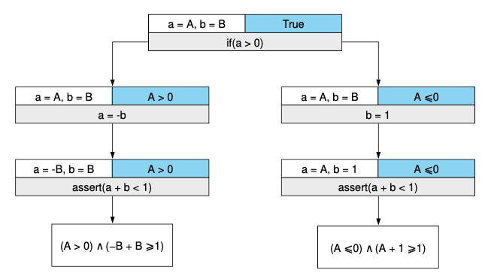
Push-button verification---symbolic execution
A more complex case

Slide 63
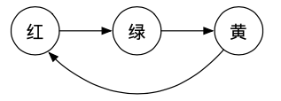
Push-button verification---model checking
Three parts to model checking
Model: a model of the system, represented as a state transition graph
Specification: usually written in temporal logic
Algorithm: exhaustive search
Spec: lights always go red

Slide 64
Limitation of push-button verification
Exhaustive search cannot handle unbounded loop
SMT solver cannot return in a limited time
To use push-button verification, rewrite program to remove unbounded loop

Slide 65
Auto-active verification---weakest precondition
W is the weakest precondition of C and Q is defined as
forall P, if P => W, than {P} C {Q} holds
Represented as wp(C, Q)
E.g., wp(x=x+1, x>2) is x>1
To prove {P} C {Q}, we need to show P => wp(C, Q)
E.g., to prove {x=2} x=x+1 {x>2}, we prove x=2 => x>1

Slide 66
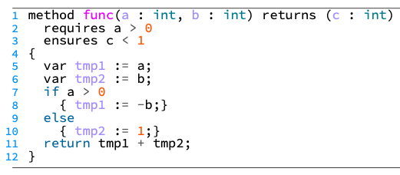
Auto-active verification---Dafny
Developed by Microsoft
Users can add annotation to help the proof
Able to handle unbounded loop

Slide 67
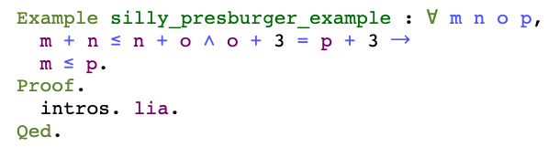
Interactive verification---Coq
Winner, 2013 ACM Software System Award
“Coq is playing an essential role in our transition to a new era of formal assurance in mathematics, semantics and program verification”
Have built-in domain specific automatic tactics
E.g., lia for Presburger arithmetic

Slide 68
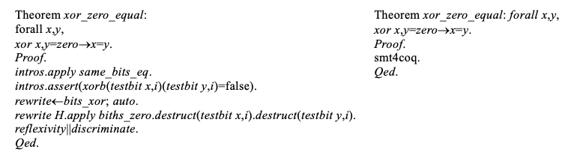
Interactive verification---Coq
Have a tactic language (Ltac) for developing automatic tactics
We can invoke SMT solver in tactics

Slide 69
Verification in academia and industry

Slide 70
Verification has gain popularity recently
Formally verified microkernels
seL4(SOSP’09): first practical verified microkernel
CertiKOS(OSDI’16): first concurrent microkernel
Formally verified compilers
CompCert (2008): a verified C compiler
Vellvm(2012): verified LLVM

Slide 71
Verification has gain popularity recently
Formally verified file systems
FSCQ (SOSP’15): first verified crash-safe file system
AtomFS (SOSP’19): first verified concurrent file system
Distributed systems, networks, cryptology, bitcoin …
Next ten years will see a surge of verification efforts

Slide 72
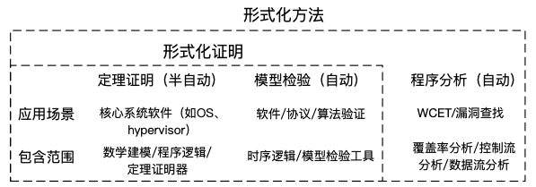
Program analysis is widely deployed in industry
Formal methods: mathematical method for developing and proving

Slide 73
Automated verification techniques is more popular in industry
Amazon: use model checking tools (TLA+) to help ensure correctness of products since 2011
“A big success at AWS”
Microsoft research pioneers in automated verification
Verification tools: Z3, Dafny
Verification projects
Vale: verified low-level crypto (adopted by Linux)
Everest: verified HPPTS replacement
Huawei makes huge investment in verification

Slide 74
Future of verification
A uniform platform for doing verification
More applications of verification to real-world systems
Big challenges and opportunities

Slide 75
Conclusion
What is verification?
Verification techniques
Now and future of verification
Thanks! Q&A

